Slide 1

Precision Manufacturing Industry Roundtable
September 24, 2024

Slide 2
Roundtable Agenda
4:25 p.m.
4:30 p.m.
5:30 p.m.
6:35 p.m.
Welcome Remarks & Kick-off
Renee John, Managing Director at Valley Vision, Dean Peckham, Executive Director at SVMA & Nick Guptil, Associate Project Manager at GSEC
Valley Vision Industry Advisory
Renee John, Managing Director at Valley Vision
Precision Manufacturing Roundtable
Nick Guptil, Associate Project Manager at GSEC
Additional Reception & Networking Time

Slide 3
Valley Vision Industry Advisory
Renee John, Managing Director at Valley Vision

Slide 4











Thank You to Our Supporters:

Slide 5
Valley Vision Industry Advisory
Ebony Joy Benzing, Director
North (Greater Sacramento) Center of Excellence for Labor Market Research

Slide 6
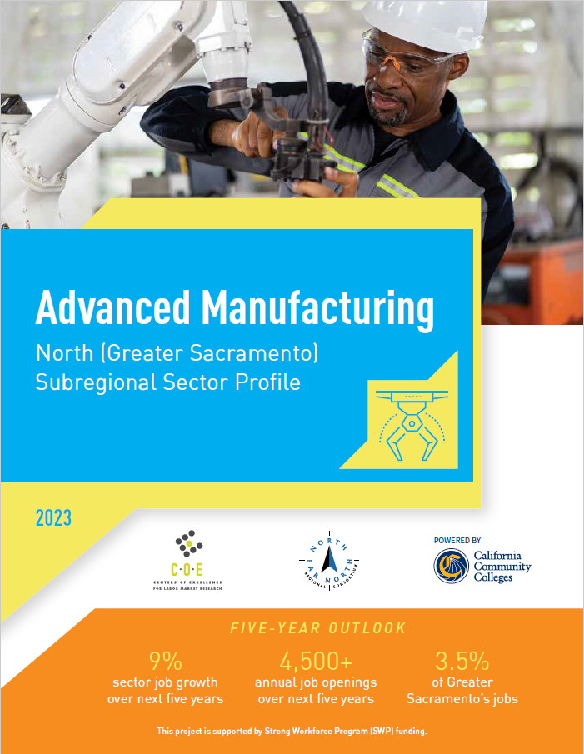
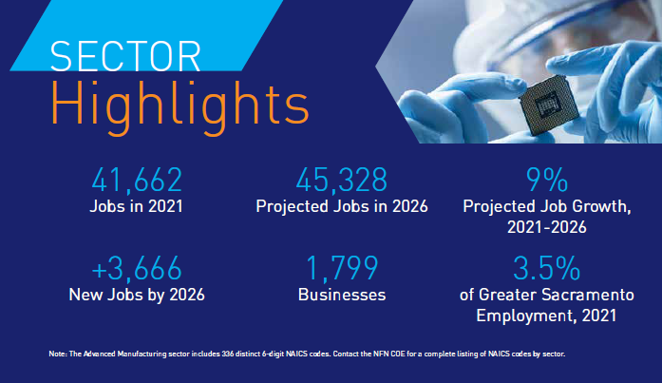
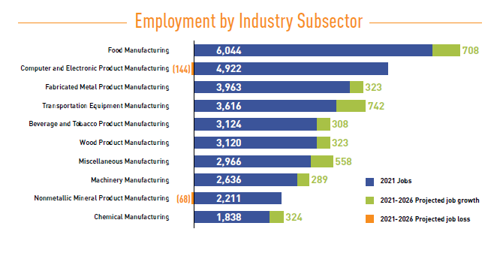
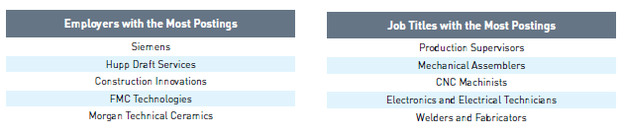
Advanced Manufacturing in Sacramento (2023)
Provides a high-level overview of the Advanced Manufacturing sector across Greater Sacramento
Jobs by subsector
Critical occupational groups
Most in-demand skills and job titles
Community college programs
Nine more sector profiles…

Slide 7


Thank you!
Ebony Joy Benzing, Director
North (Greater Sacramento) Center of Excellence for Labor Market Research
Part of the North Far North COE, hosted by Los Rios Community College District
ebony.benzing@losrios.edu
916.563.3215
coeccc.net
Access all 10 sector profiles here:

Slide 8
Valley Vision Industry Advisory
Tell us about yourself, your business, the type of manufacturing you do , and the size of your workforce.
What are the key occupations and skill needs you have? What positions do you have the most difficulty filling?
How do you see the types of skills needed for manufacturing changing as a result of market dynamics (policy, automation/technology, environmental)?

Slide 9
Valley Vision Industry Advisory
What is your experience, if any, partnering with education and training providers including community colleges?
Do you have suggestions for how individuals or students can be better prepared for positions in manufacturing?

Slide 10
Thank You for Joining!
For more information, please contact:
Renee John, Managing Director, Valley Vision
renee.john@valleyvision.org
Caitlin Blockus, Project Manager, Valley Vision
caitlin.blockus@valleyvision.org

Slide 11
Precision Manufacturing Roundtable
Nick Guptil, Associate Project Manager at GSEC

Slide 12
Precision Manufacturing Industry Roundtable
How has the regional or state economy affected your business?
What can change about the business environment to help your company or industry be more successful?
What specific information, datasets, or trends would you like to have access to?

Slide 13
Precision Manufacturing Industry Roundtable
Does your company provide any additional support to your workforce such as childcare or transportation incentives?
What services do you need to support your company’s growth and innovation in the region?
What would cause you to relocate out of the Capital Region? Where would you consider expanding your operations or moving to?

Slide 14
Thank you!

